Slide 1




Teacher Strategy
Sentence Detective: Using Function Questions
This deck is for teachers to use with the Reading Universe Sentence Detective: Using Function Questions lesson plan and activity. It offers two teaching strategies for teaching the lesson: Sentence Unpacking (to support reading comprehension) and Sentence Expansion (to support writing).
Here’s how to use the slides in the lesson. Feel free to modify the content if you need to!
Slide #2 is an example of Sentence Unpacking.
On Slide #3, you will add your own sentence(s) for unpacking to the template.
Slide #4 is an example of Sentence Expansion.
On Slide #5, you will add your own sentence(s) for sentence expansion to the template.
You can use the question cards in slide #6 to illustrate your sentence.
You can make copies of slides #3 and #5 to have more than one example.
You will need to delete slides #1, 2, and 4 before projecting this lesson for your students.
Language Comprehension | Sentences
ReadingUniverse.org | © WETA

Slide 2



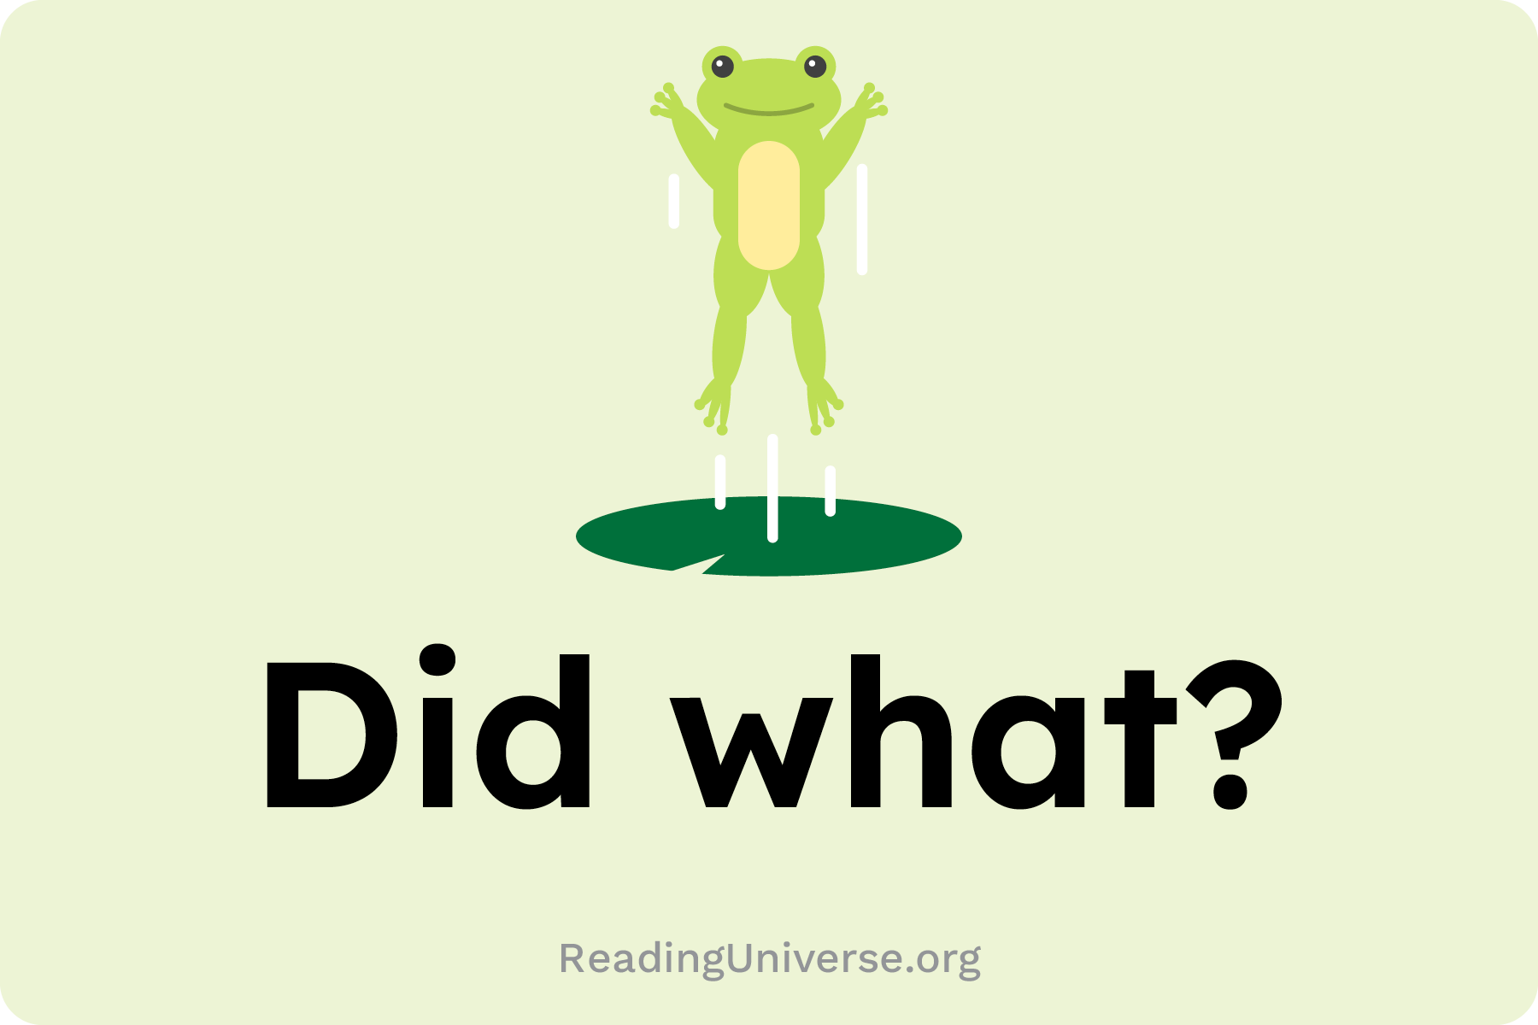

Teacher Strategy
Example Slide for Sentence Unpacking
Sentence: The tiny staple fell on the ground.
staple
tiny
fell
on the ground
Language Comprehension | Sentences
ReadingUniverse.org | © WETA

Slide 3
[Write your sentence here.]
Copy and paste question card
Copy and paste question card
Copy and paste question card
Copy and paste question card
[answer]
[answer]
[answer]
[answer]
Language Comprehension | Sentences
ReadingUniverse.org | © WETA

Slide 4
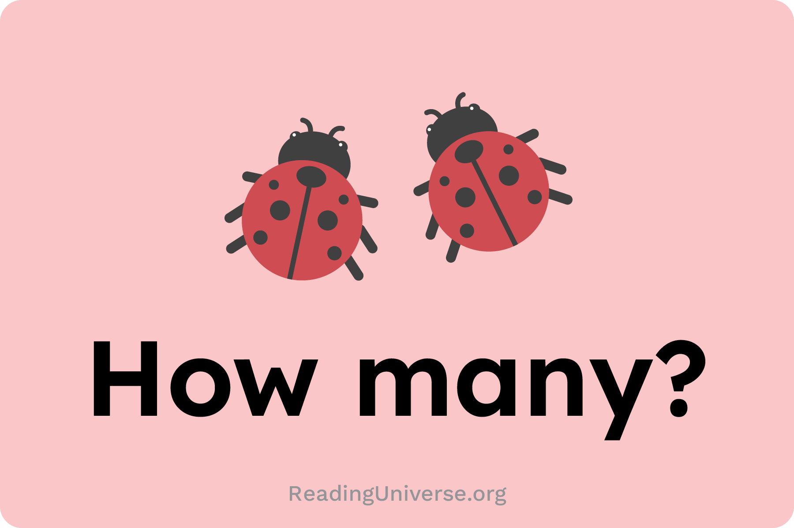
Teacher Strategy
Example Slide for Sentence Sentence Expansion
Sentence: The beetle jumped.
small
five
on the sidewalk
Expanded Sentence:
Five small beetles jumped on the sidewalk.
Language Comprehension | Sentences
ReadingUniverse.org | © WETA

Slide 5
[Simple Sentence: Write your sentence here]
Copy and paste question card
Copy and paste question card
Copy and paste question card
Expanded Sentence:
Language Comprehension | Sentences
ReadingUniverse.org | © WETA

Slide 6

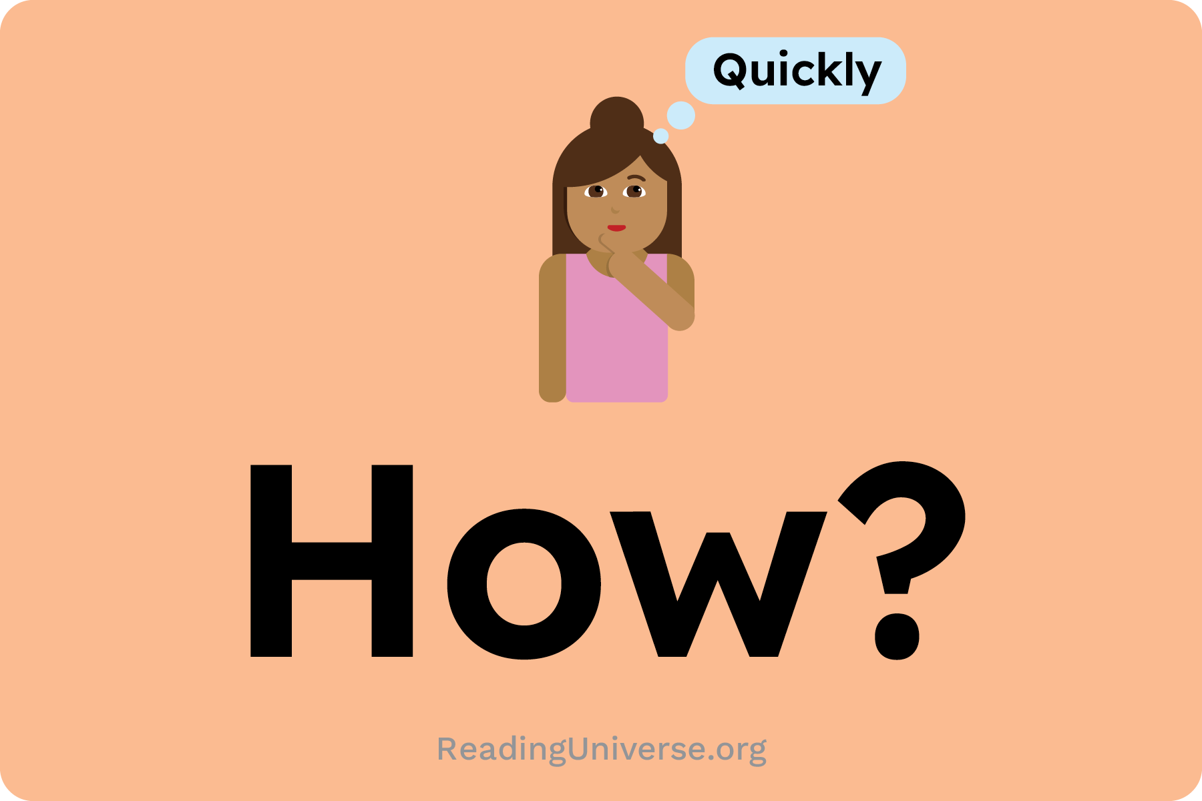
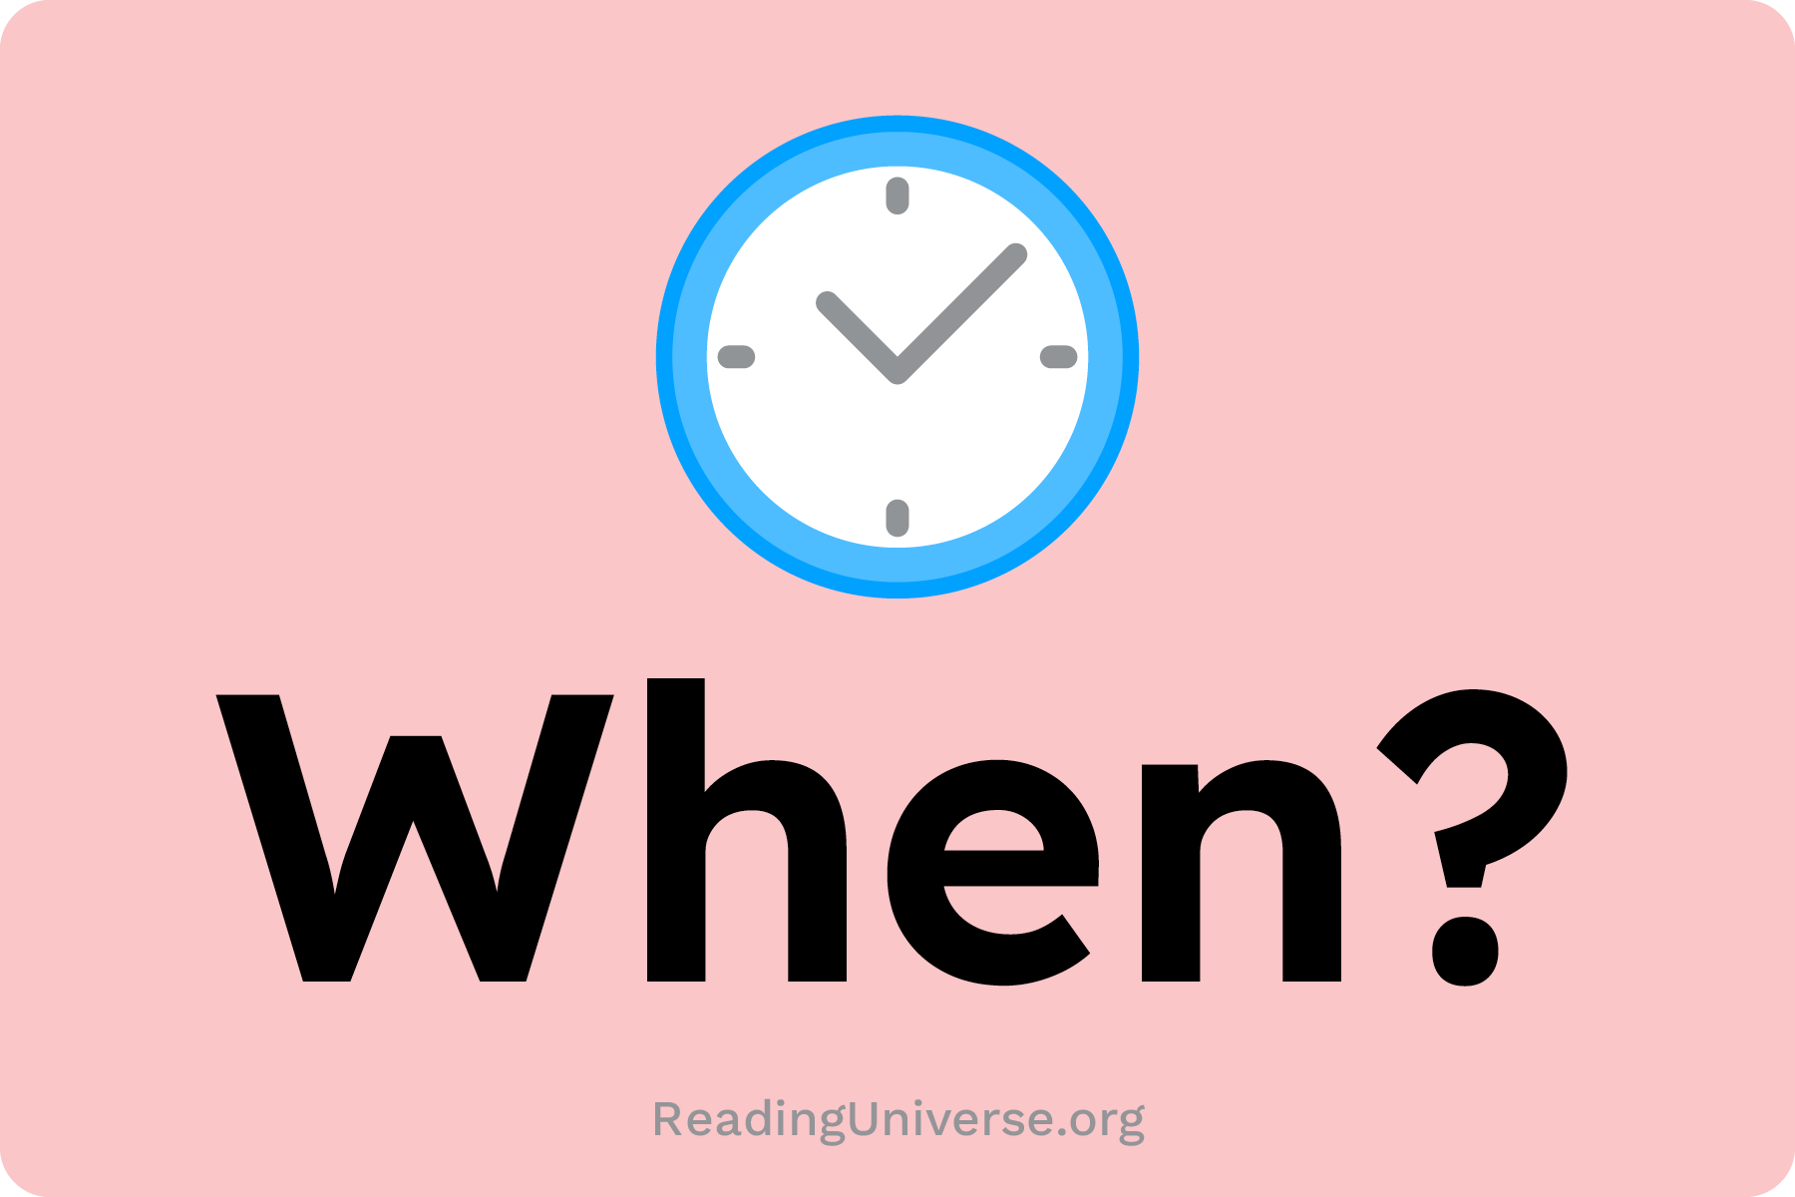
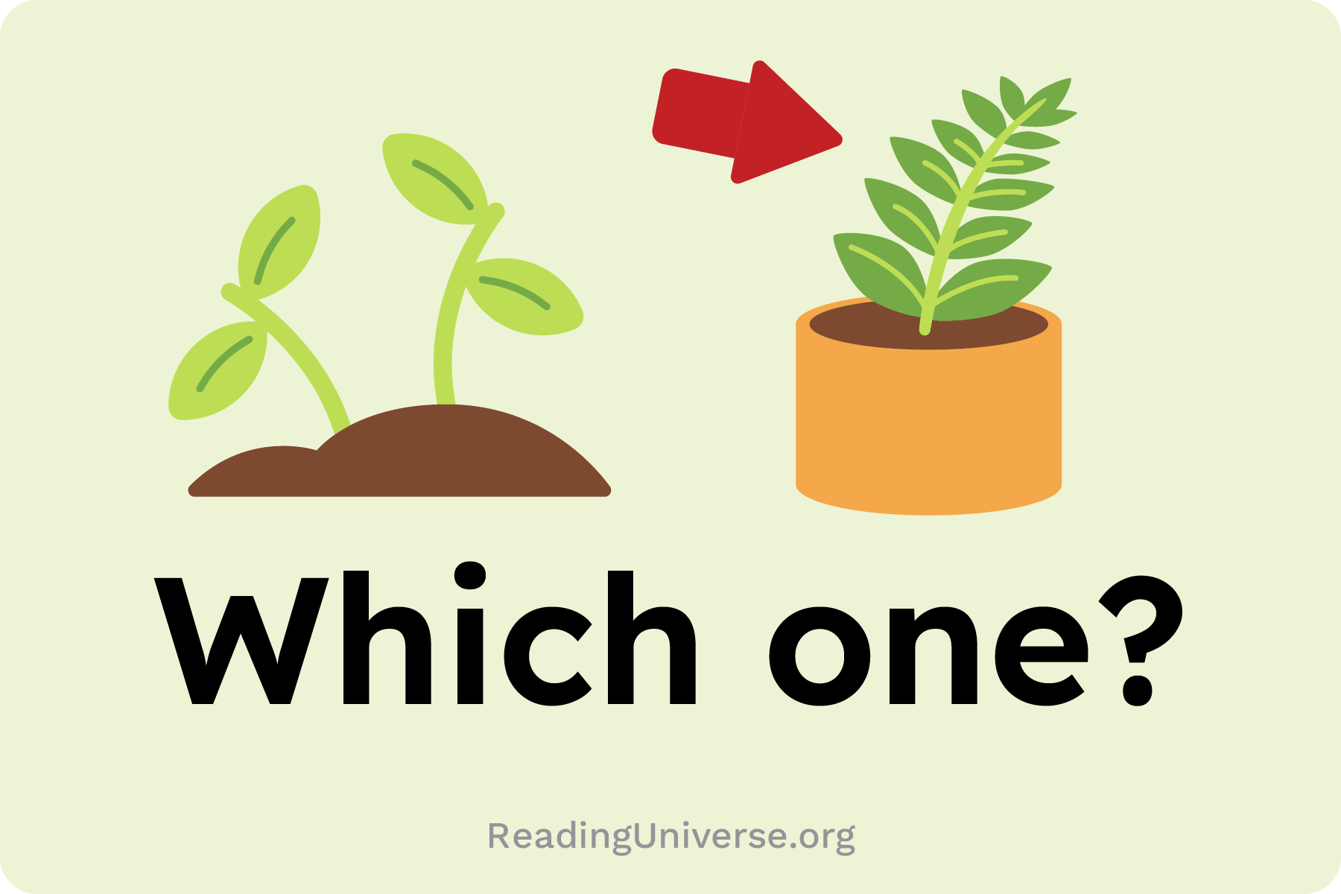
Teacher Strategy
Copy and paste these cards into slides 3 and 5
to match question to your sentences:
Language Comprehension | Sentences
ReadingUniverse.org | © WETA

